Slide 1
Video Game Global Sales
Presented By
Aishwariya Chunduru
Anusha Kirigere
Himali Shewale
Sonam Desai
Vaishnavi Inamdar
MIS 649 - Business Analytics

Slide 2
Why Video games?
Video Games industry is one of the fastest growing industry today. It has gone from niche to mainstream.
As of July 2018, video games generated $134.9 Billion USD.
Industry has influenced technology advancements of PC through sound cards , graphics cards and 3D graphics accelerators, CPUs and processors.
Notes:
Aish

Slide 3
Dataset
Our dataset was sourced from Kaggle, while the Video game sales from Vgchartz and corresponding ratings from Metacritic. The original dataset consists 16720 observations with 16 columns.
We removed the five variables that we will not put into consideration and cleaned the dataset by removing the missing values to finalize a cleaned dataset we would like to proceed with our analysis, which consists of 6947 observations and 13 variables.
Removed the ‘NA_Sales’, ‘EU_Sales’,’JP_Sales’ and ‘Other_Sales’ columns from the dataset.
URL: https://www.kaggle.com/datasets/rush4ratio/video-game-sales-with-ratings
Notes:
Aish

Slide 4
Variables
Quantitative Variables | Qualitative Variables
Global Sales (Response Variable) | Name
Critic_Score* | Platform
Critic_Count* | Year_of_Release
User_Score* | Genre
User_Count | Publisher
 | Developer
 | Rating
Notes:
Aish

Slide 5
Libraries Used
Corrplot 🡪 Creating the correlation plots among the variables
ISLR2 🡪 For linear regression process
Leaps 🡪 For Forward Step Selection
randomForest 🡪 For building prediction model with random forest method
Ggplot2 🡪 Creating complex plots from data in a data frame
Dplyr 🡪 For data manipulation
Caret 🡪 For the model training process for complex regression
Notes:
Aish

Slide 6
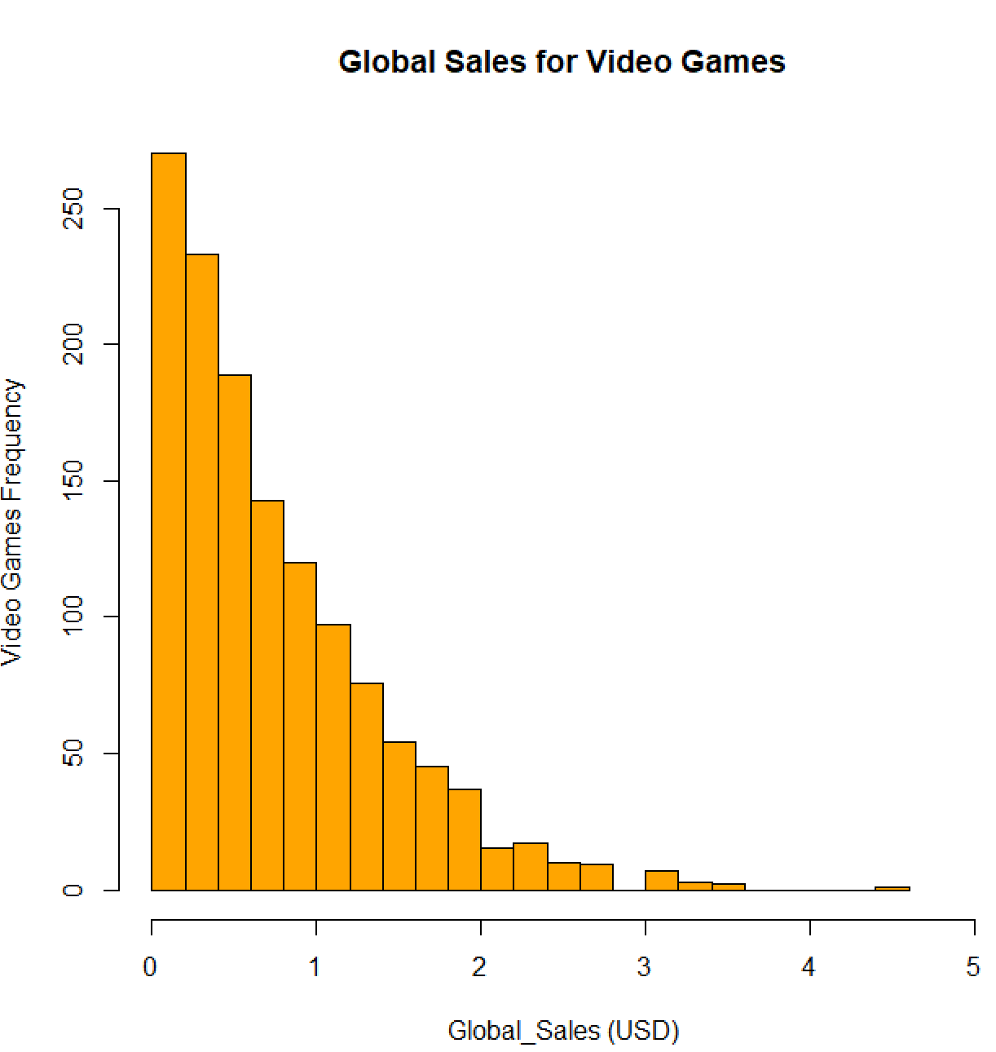
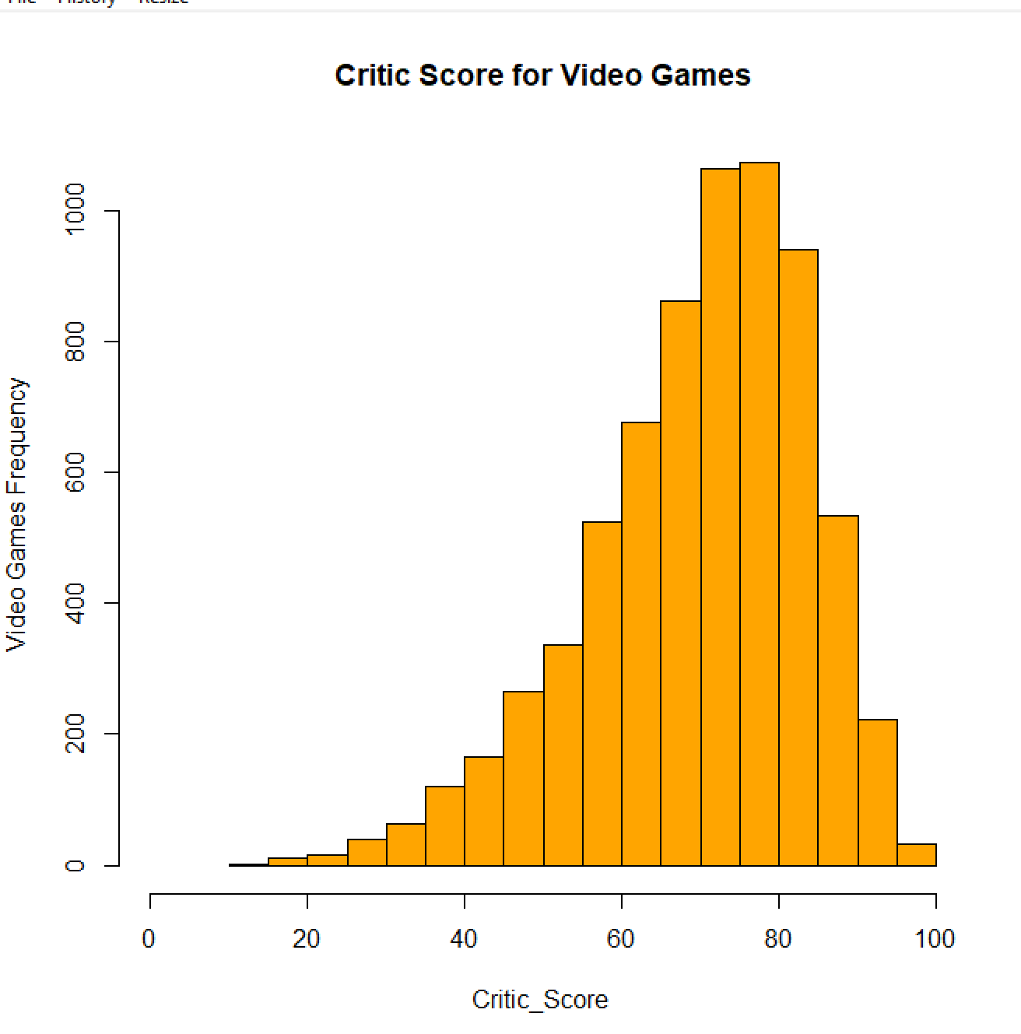
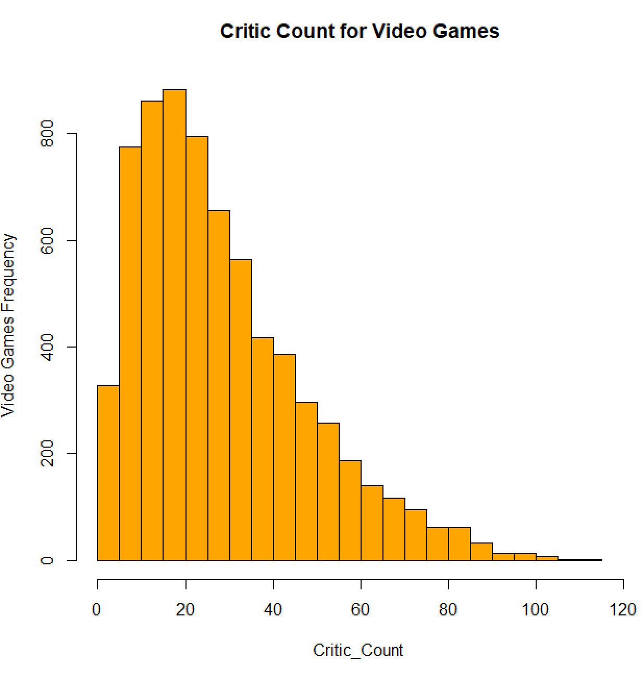
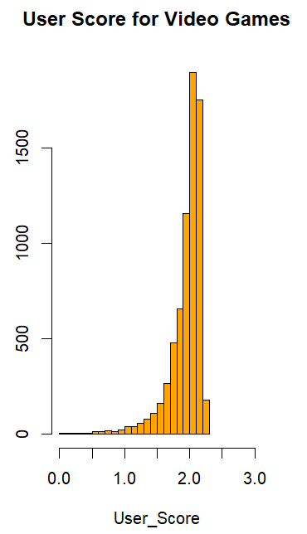
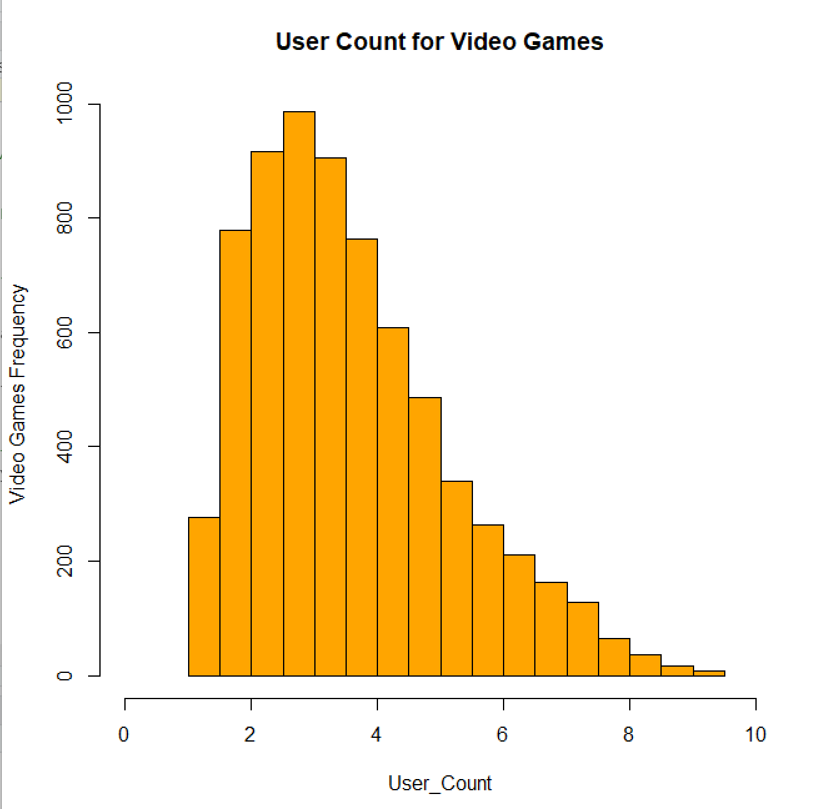
Histograms
Notes:
Himali
Histograms are used to display the distribution of a continuous variable. They provide information about the shape, center, and spread of the distribution.
By examining the histogram, we can identify:
Shape: Whether the distribution is symmetric, skewed to the left or right, bimodal or uniform.
Center: Where the distribution is centered or concentrated, based on the peak or mode of the distribution.
Global Sales, Critic Count , User Count - Positively Skewed
Critic Score and user score - Negatively Skewed

Slide 7
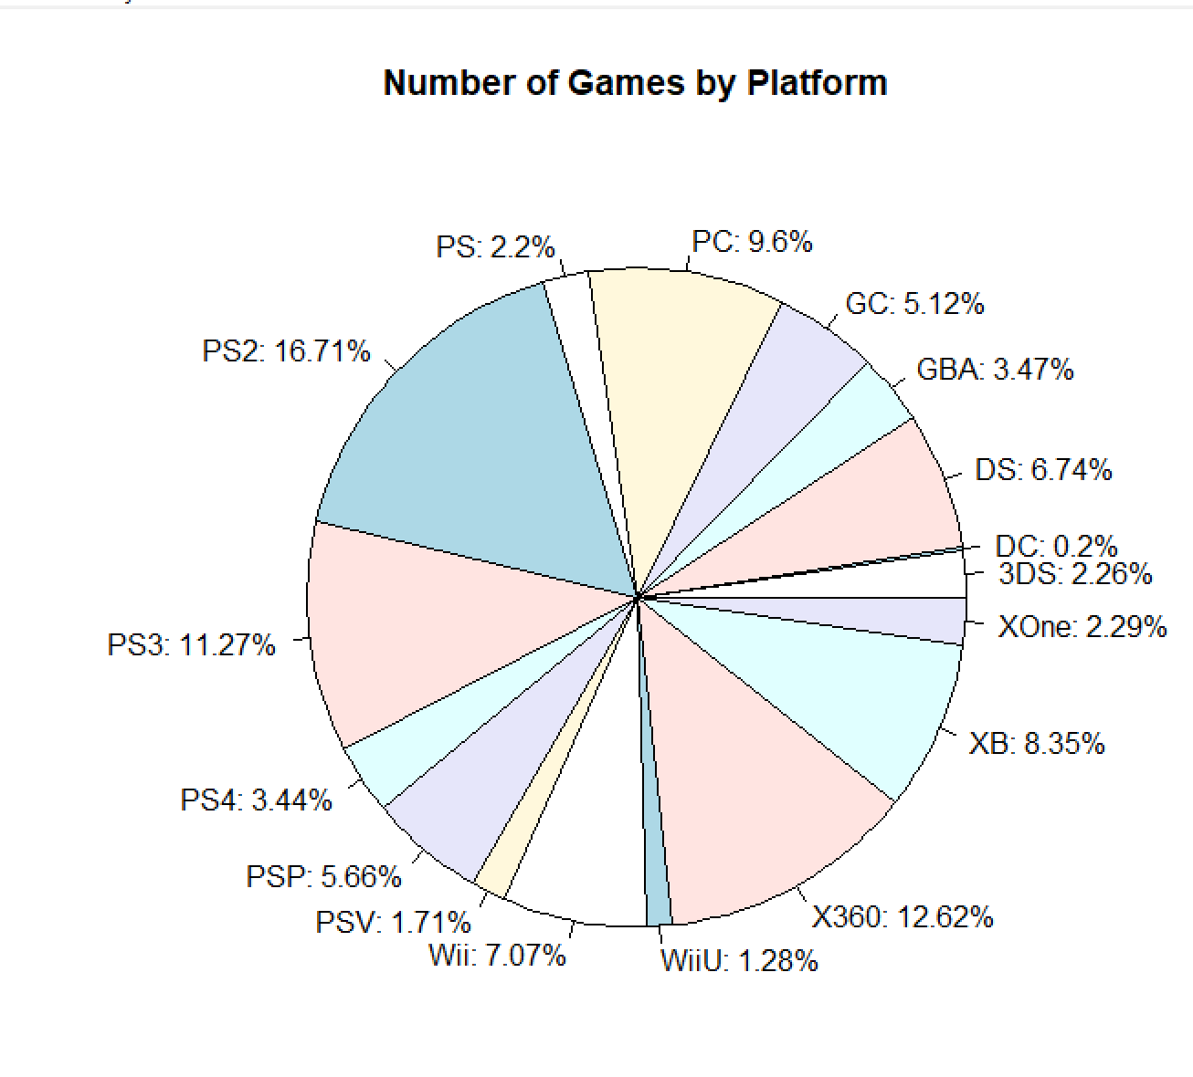
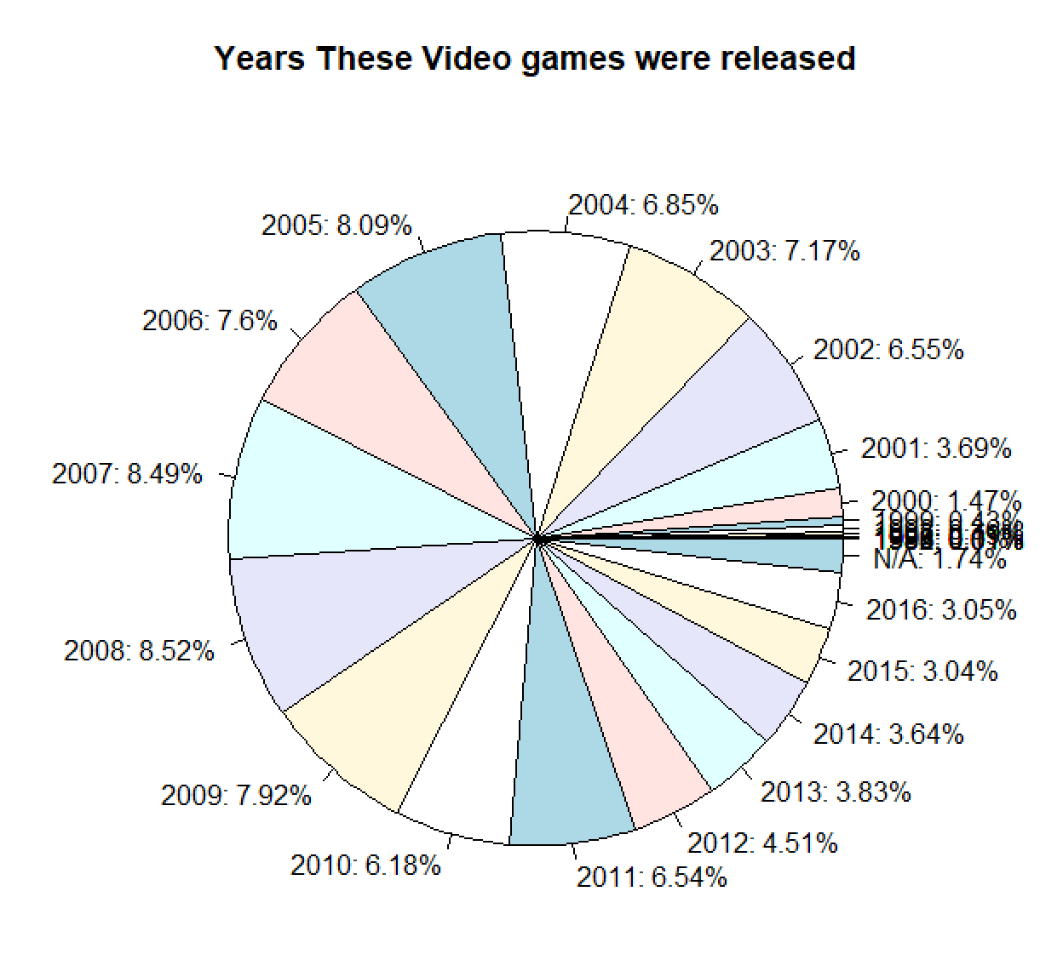
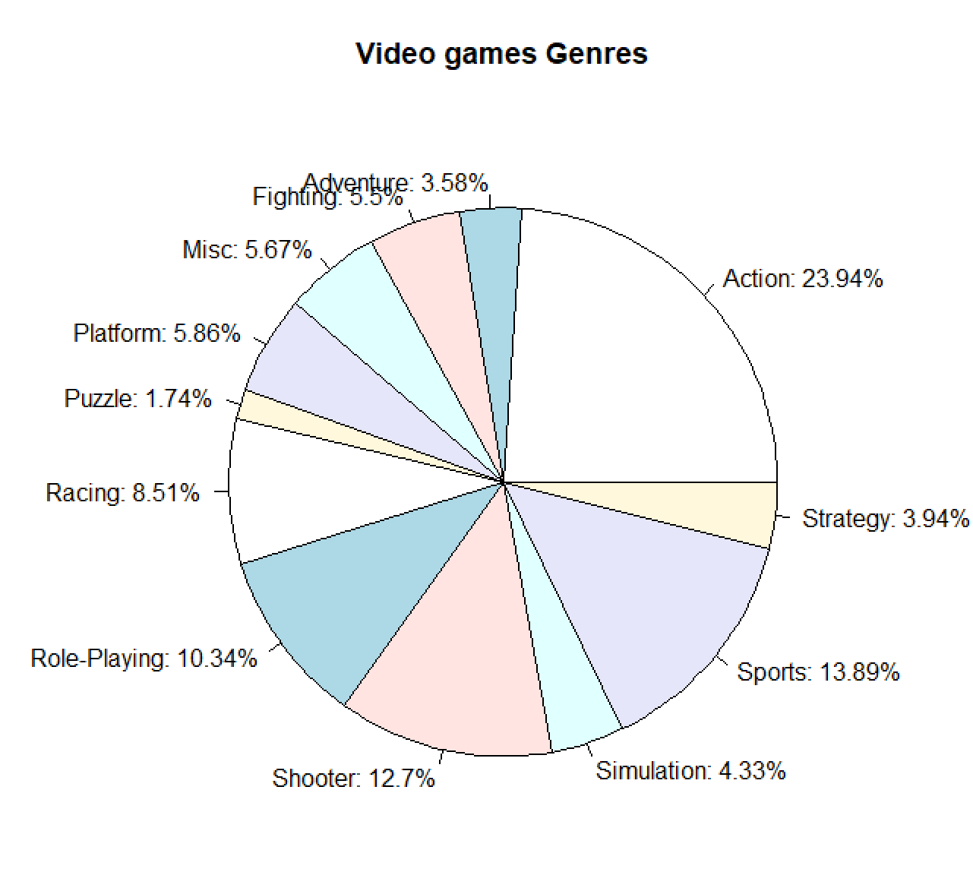
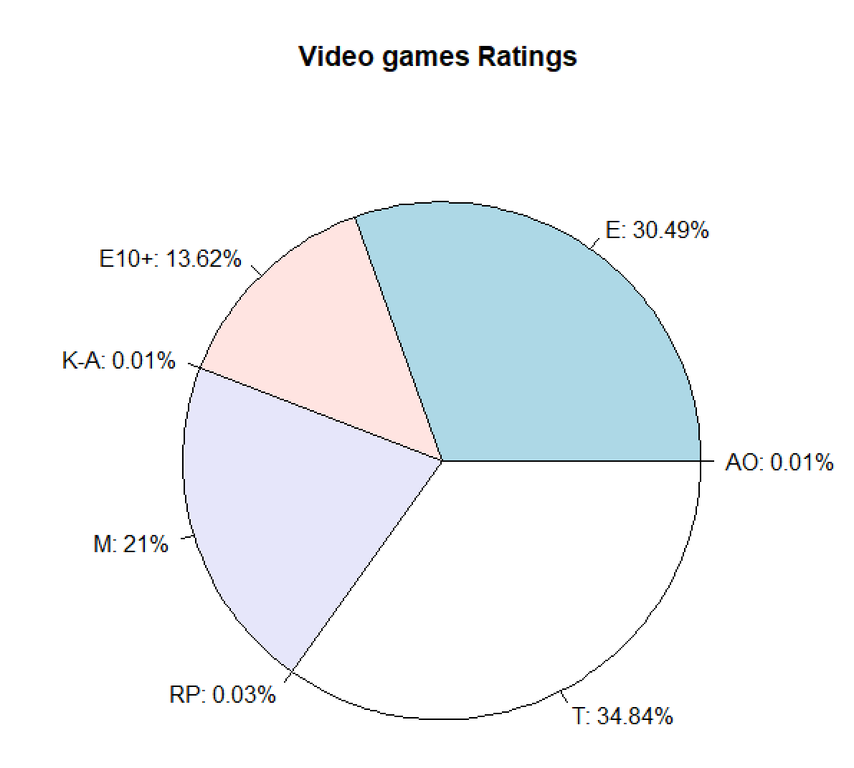
Pie Charts
Notes:
A pie-chart is a representation of values as slices of a circle with different colors. The slices are labeled and the numbers corresponding to each slice is also represented in the chart.
In R the pie chart is created using the pie() function which takes positive numbers as a vector input.
Here we can see game Genres Pie chart, we can see bigger slice percent is for action i .e 23.94 % and lowest game genres percent is for puzzle games i.e 1.74%

Slide 8
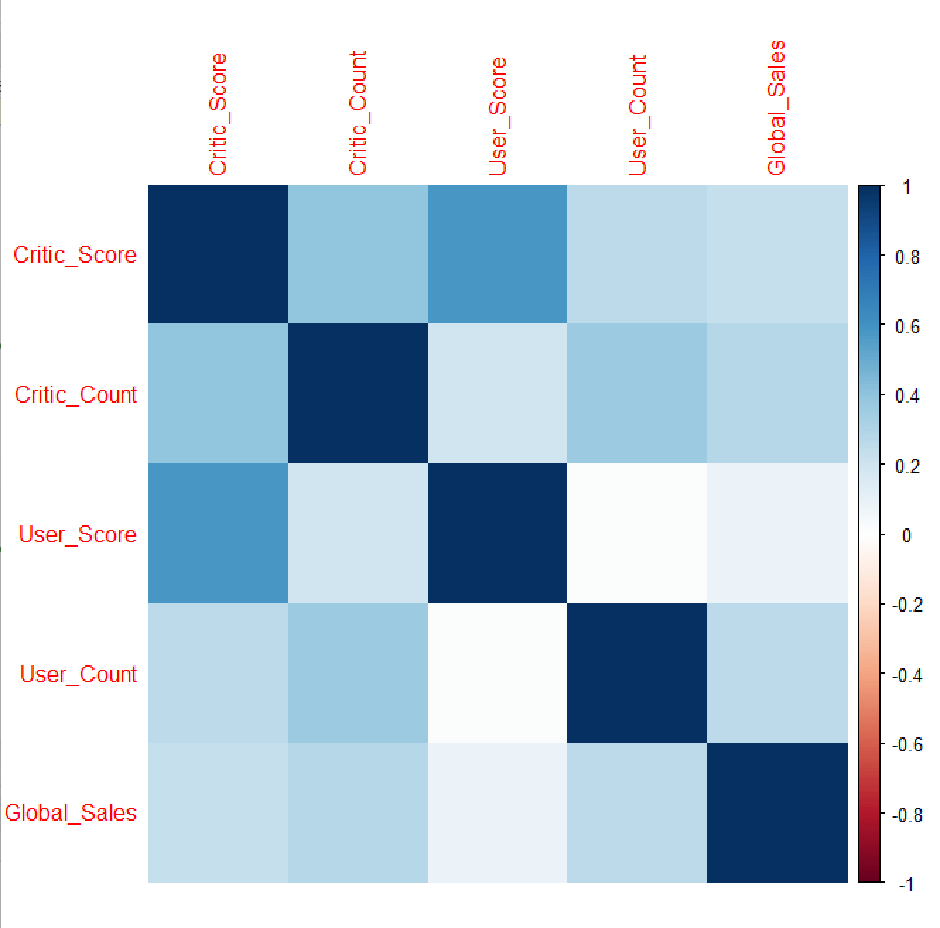
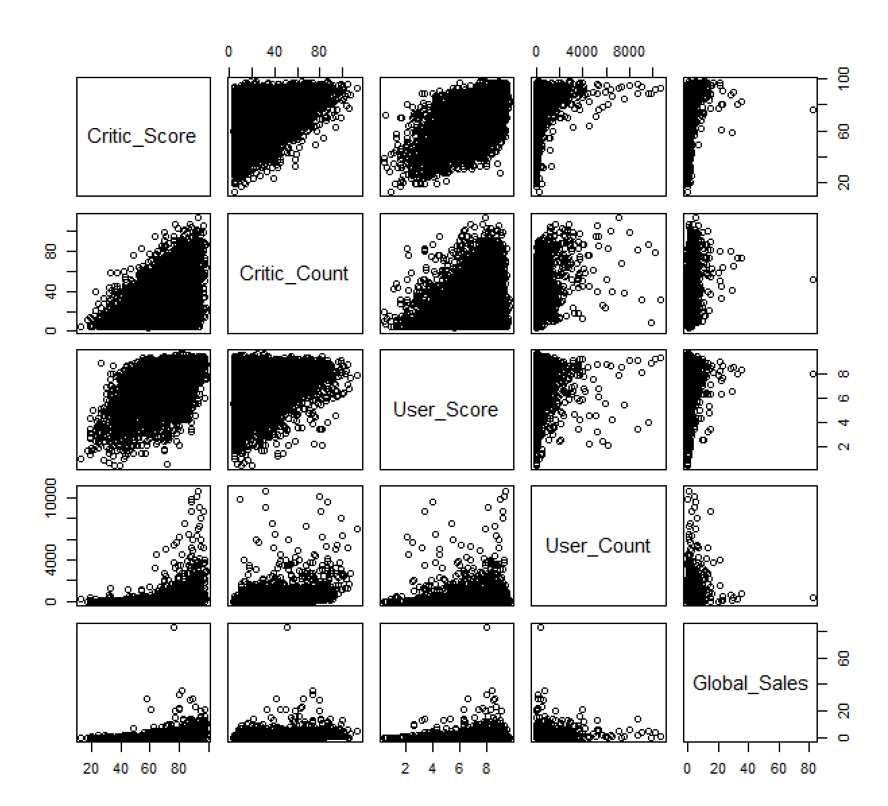
Correlation Plot for Quantitative Variables
Notes:
Himali
Here we can see scatter plot and correlation plot for quantitative variables. Correlation plots measures the relationship between two variables
In a correlation plot, variables that are positively correlated will have a value close to 1, while variables that are negatively correlated will have a value close to -1. Variables that are not correlated will have a value close to 0.
User Score and Critic Score are highly correlated.

Slide 9
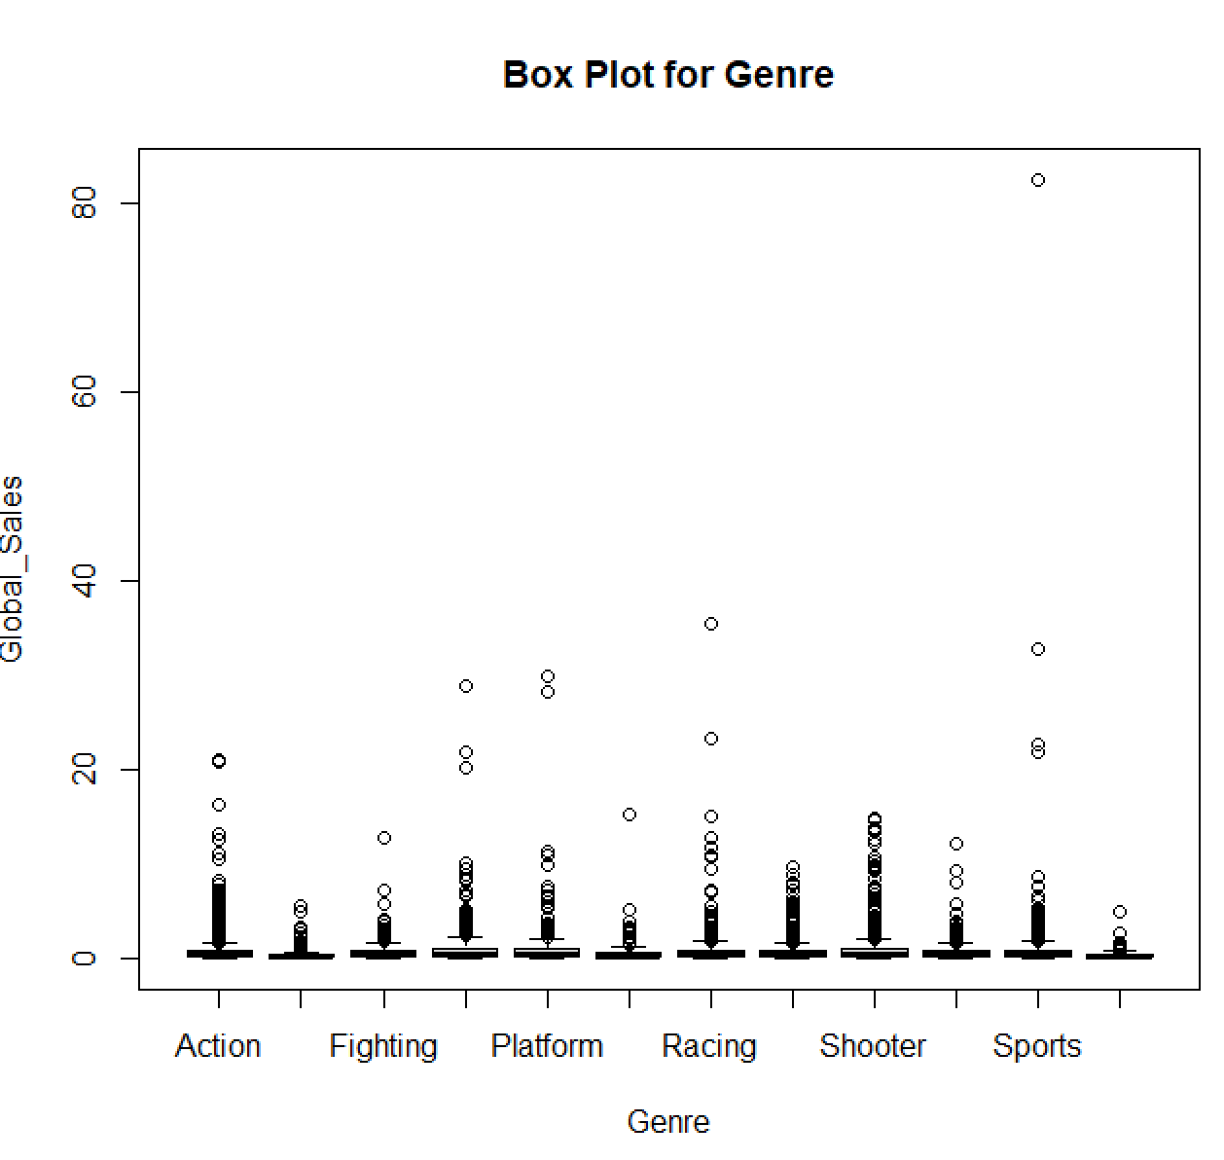
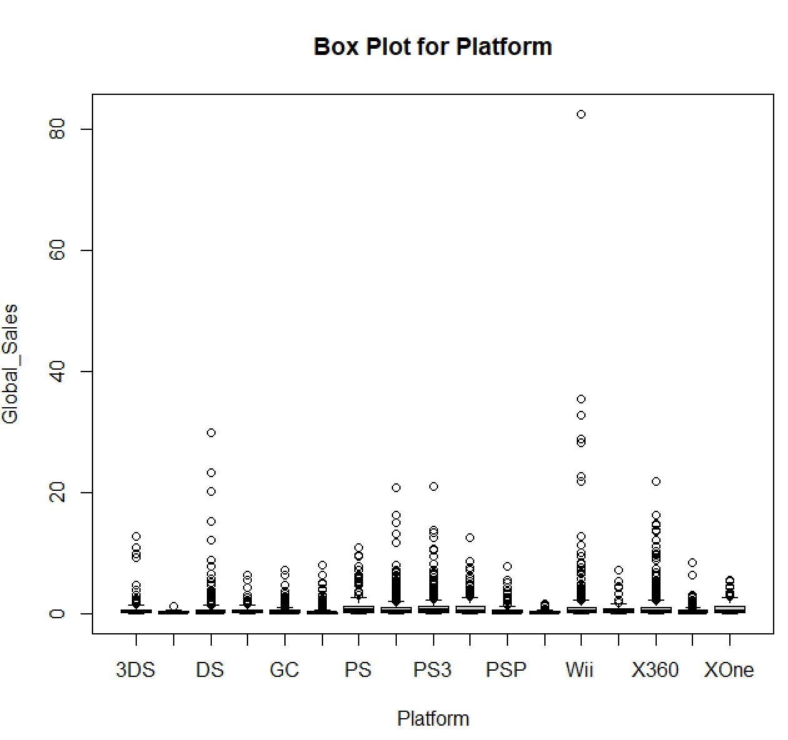
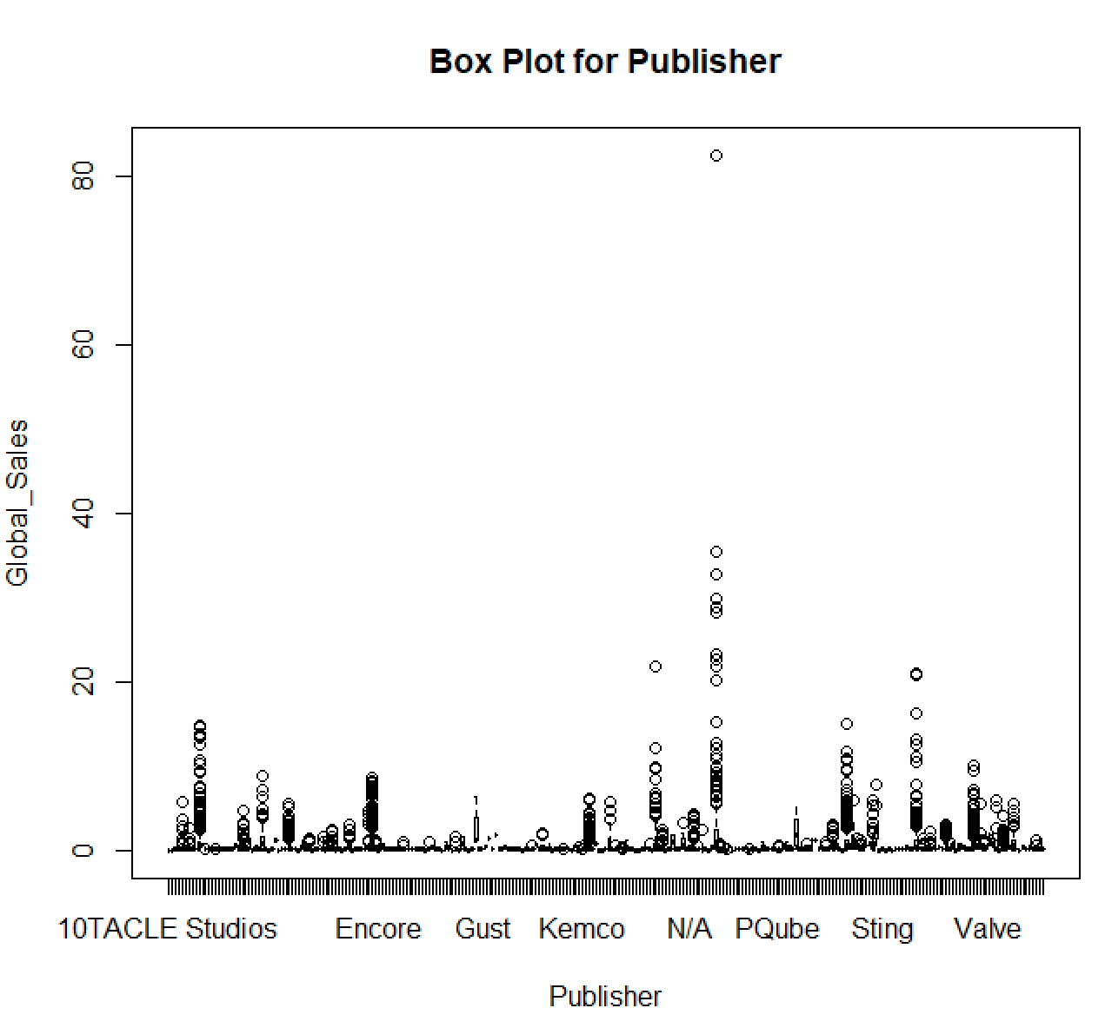
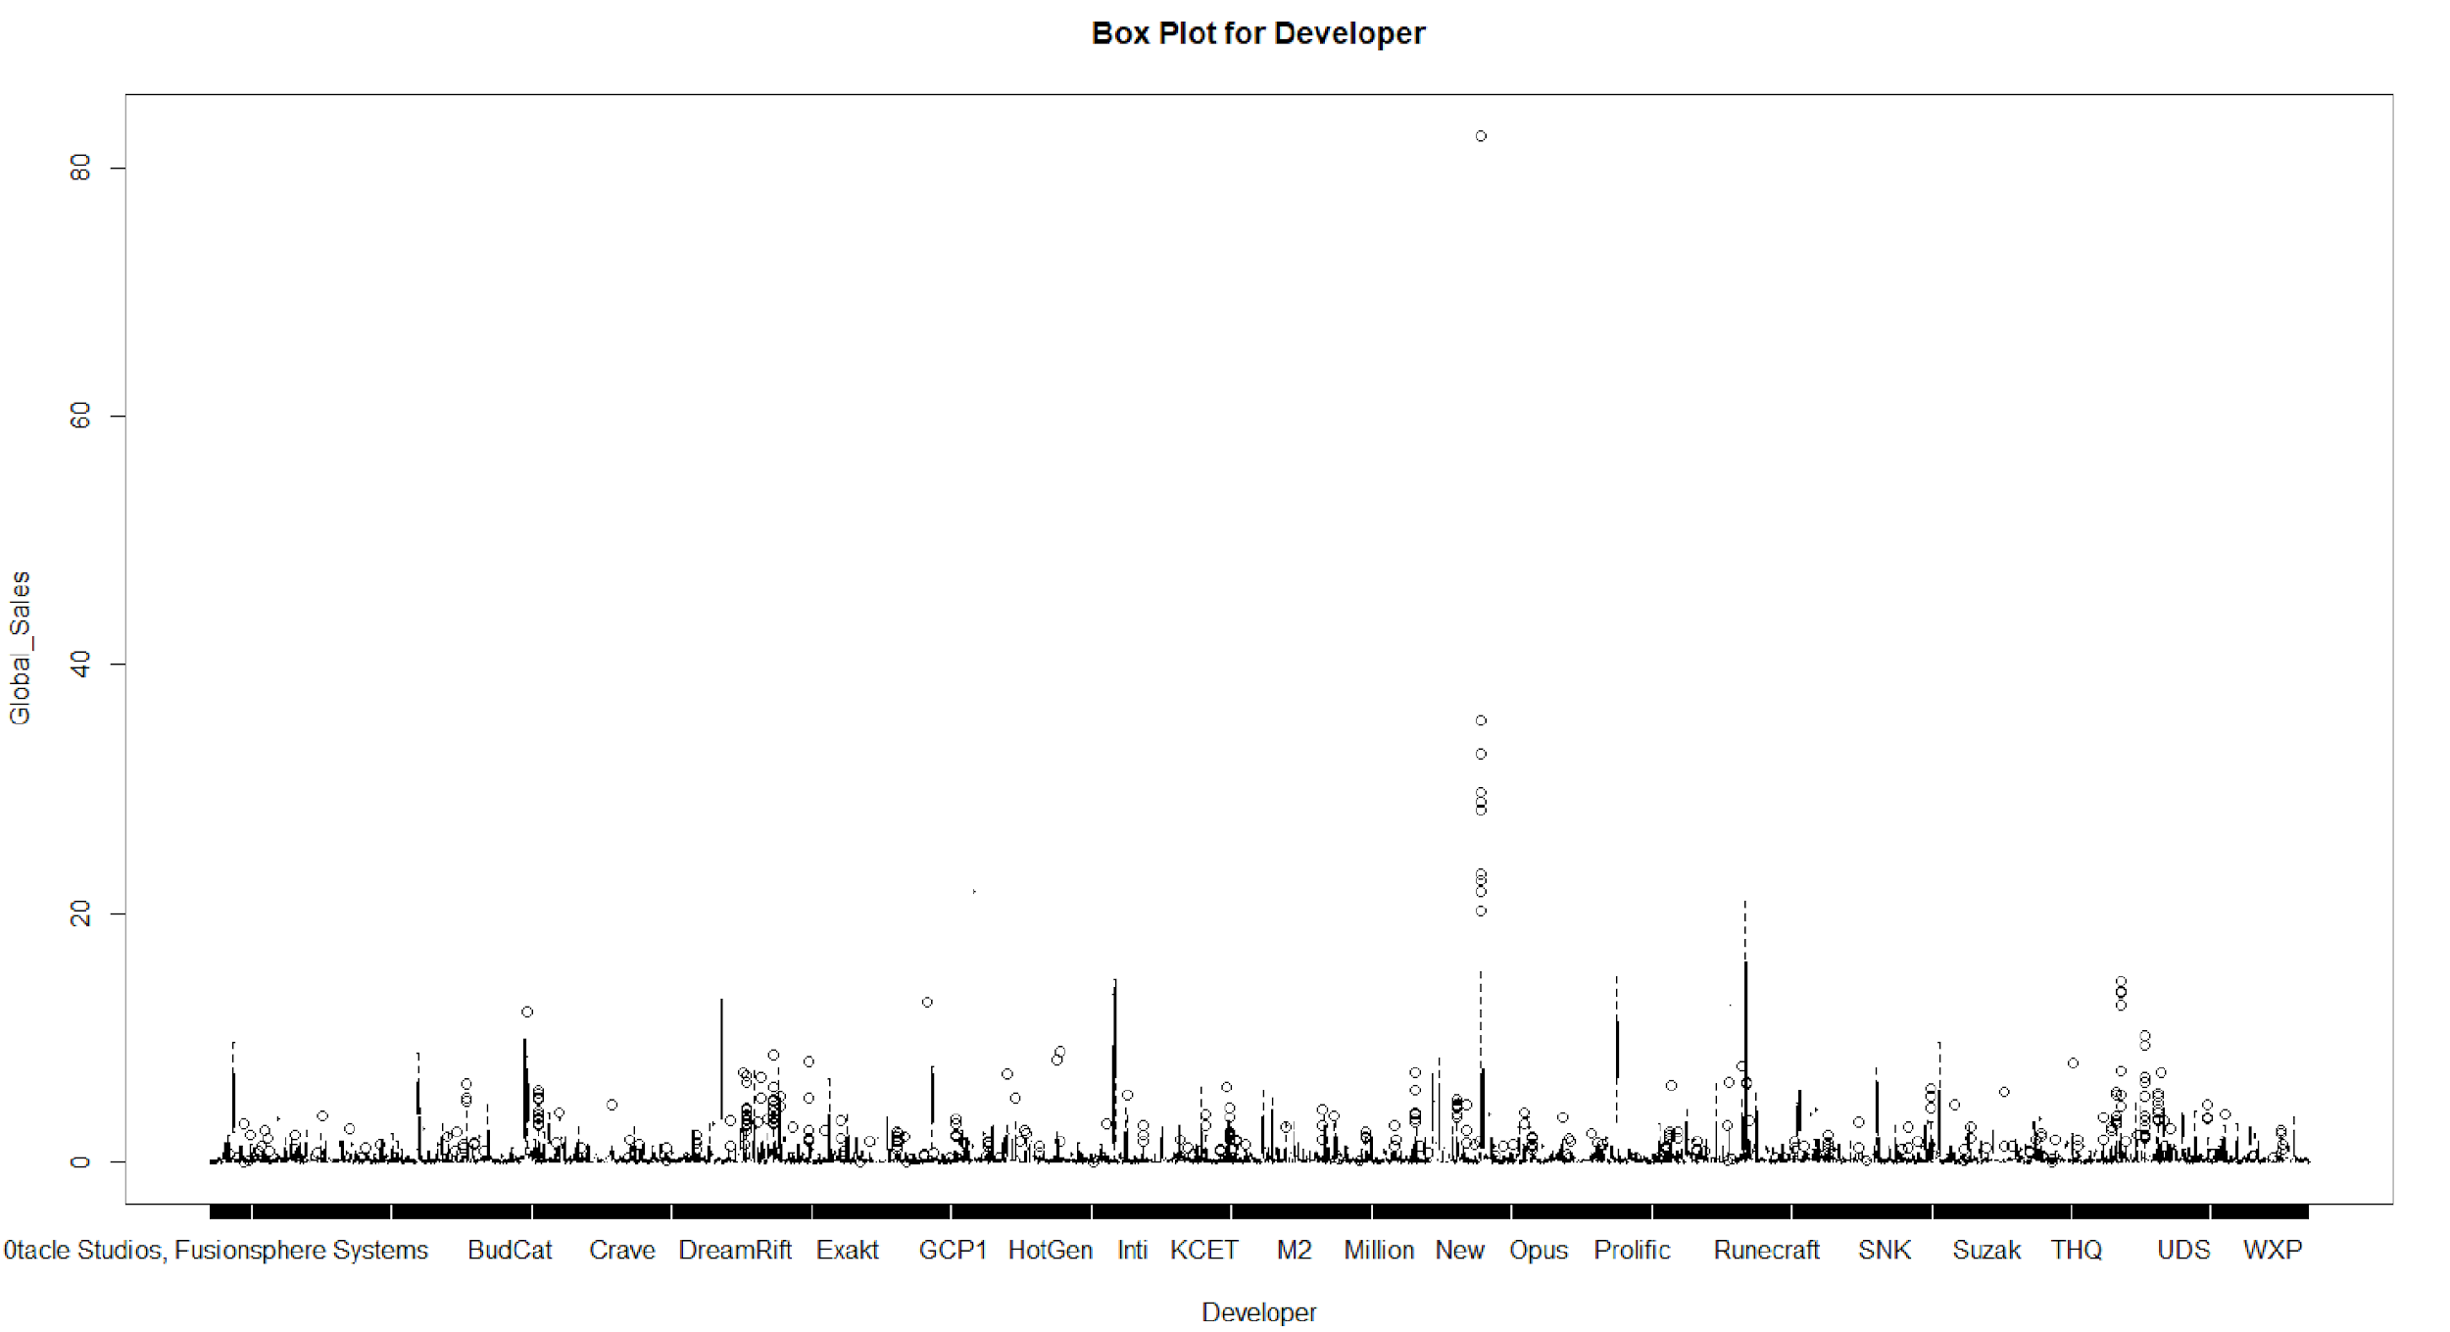
BOX Plots for Qualitative Variables
Notes:
Himali
Box plots are often used to visualize the distribution of a continuous variable by showing the median, interquartile range, and any outliers. Box plots can also be used to compare the distributions of a continuous variable across different groups.
As our response variable is global sales we plotted box plot with respect to it. here box plots for genre, platforms, publishers and developers. If we consider genre, we can see different genres like Actine, fighting, platform, racing and highest value with sports genre
Thank You
passing to sonam

Slide 10
Multivariate Regression Model
Definition: A multivariate regression model is a statistical model used to analyze the relationship between a dependent variable and two or more independent variables.
Y = β0 + β1X1 + β2X2 + β3X3 + ... + βnXn + ε
AIC - 17893.53
BIC - 17932.46
MSE:-
Linear - 5.685017
Quadratic Polynomial - 5.771518
Cubic Polynomial - 5.729701
Notes:
Sonam
multivariate regression models are useful when we want to predict a response variable based on multiple predictors and control for other variables that could influence the relationship between the predictors and the response.
By using multiple independent variables in a regression model, we can control for confounding factors and better understand the relationship between the dependent variable and independent variables. This can help to make more accurate predictions and better understand the drivers of a particular outcome.
A quadratic regression model involves squaring the independent variable, and a cubic regression model involves cubing the independent variable. These models can capture non-linear relationships between the dependent and independent variables.
> AIC(lm1)
[1] 17893.53
> BIC(lm1)
[1] 17932.46

Slide 11
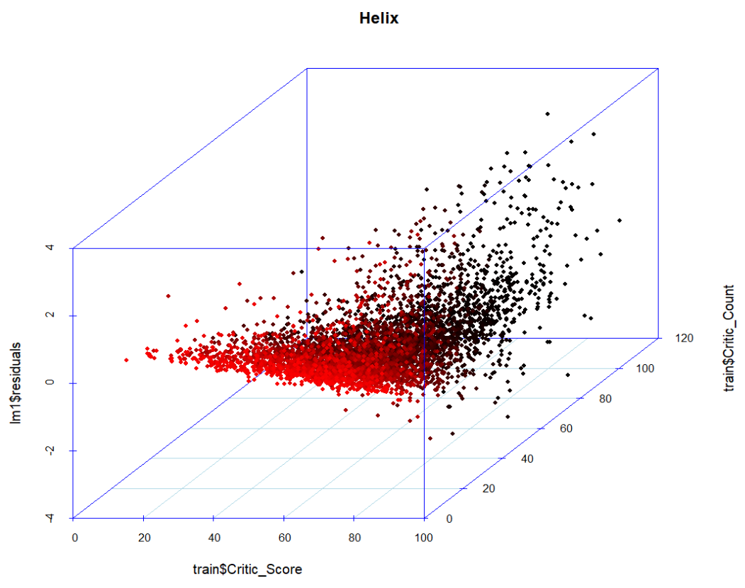
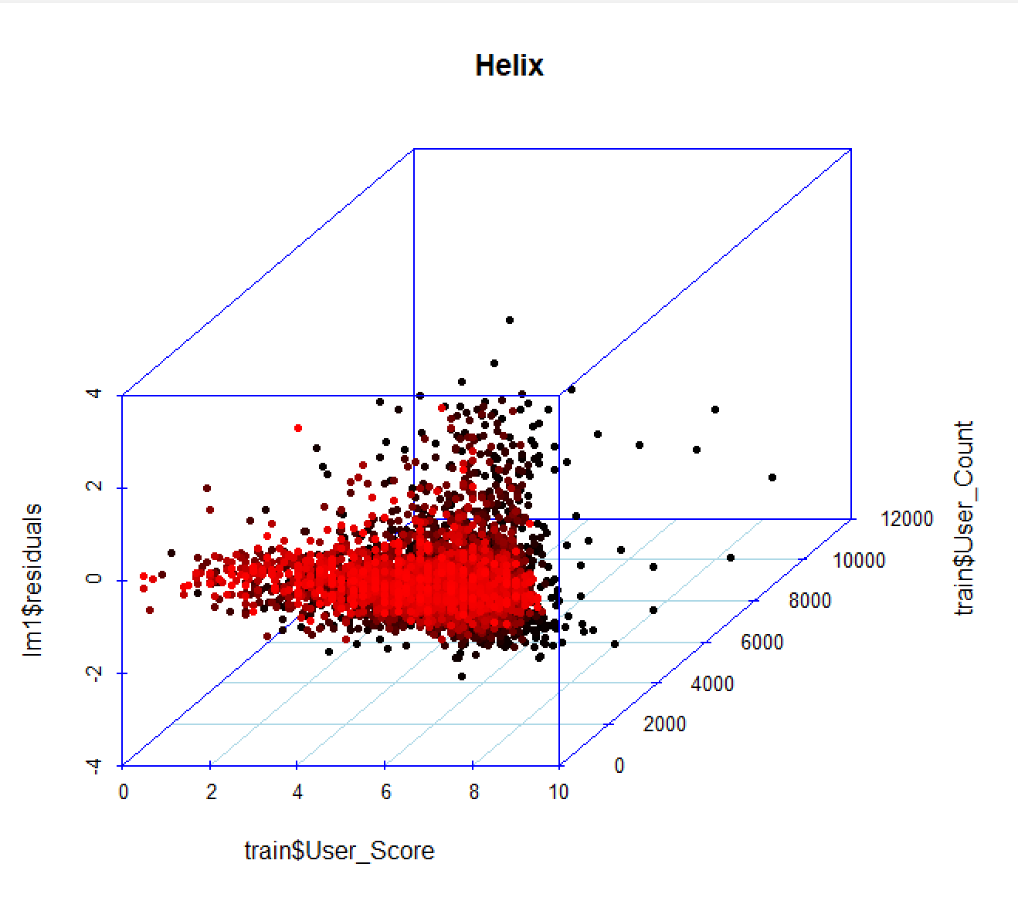
Residual Plot
Critic Score vs Critic Count vs Residuals
User Score vs User Count vs Residuals
Notes:
Sonam
A residual plot is used to check the goodness of fit of a regression model. It plots the residuals, which are the differences between the observed values of the dependent variable and the predicted values from the regression model, against the predicted values. The residual plot helps in determining the following:
the residuals form a funnel shape , it indicates that the variance of the residuals is not constant across the range of the predicted values. This is called heteroscedasticity, and it violates one of the assumptions of linear regression. In this case, the model may need to be transformed or a different modeling approach may need to be considered.
> mean((test.y - lm1.pred1)^2)
[1] 5.685017
> mean((test.y - lm2.pred2)^2)
[1] 5.771518
> mean((test.y - lm3.pred3)^2)
[1] 5.729701

Slide 12
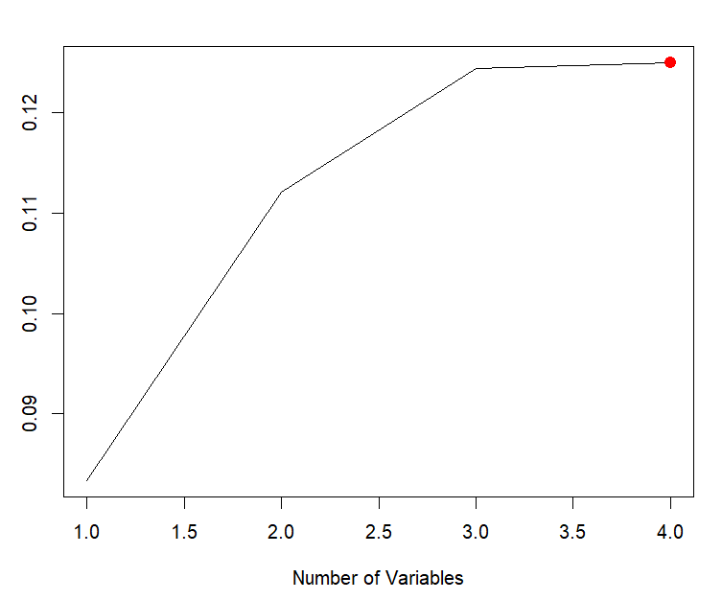
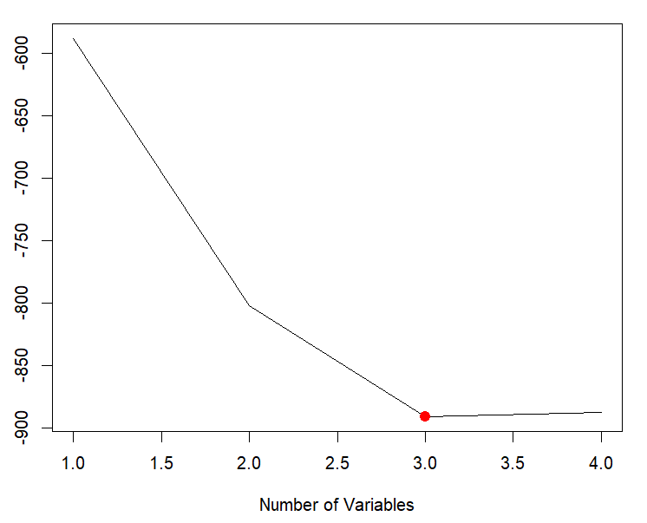
Feature Selection - Forward Stepwise and Backward Selection
Variable Selection based on Smallest BIC and Largest Adjusted R^2 - Critic_Score, Critic_Count, User_Score, User_Count
Notes:
Sonam
Both techniques are used to identify the most important features or predictors to be included in the final model.
Both forward selection and backward selection can be used in dataset to reduce the number of features in the model and improve the efficiency of the model.
However, it is important to note that these methods can be computationally intensive and may not always result in the best subset of features for the model. It is also important to consider the interpretability of the selected features and their relevance to the problem being solved. Therefore, it is recommended to use these methods in combination with domain knowledge and other feature selection techniques such as regularization methods (e.g., Lasso, Ridge), principal component analysis (PCA), and mutual information-based feature selection.

Slide 13
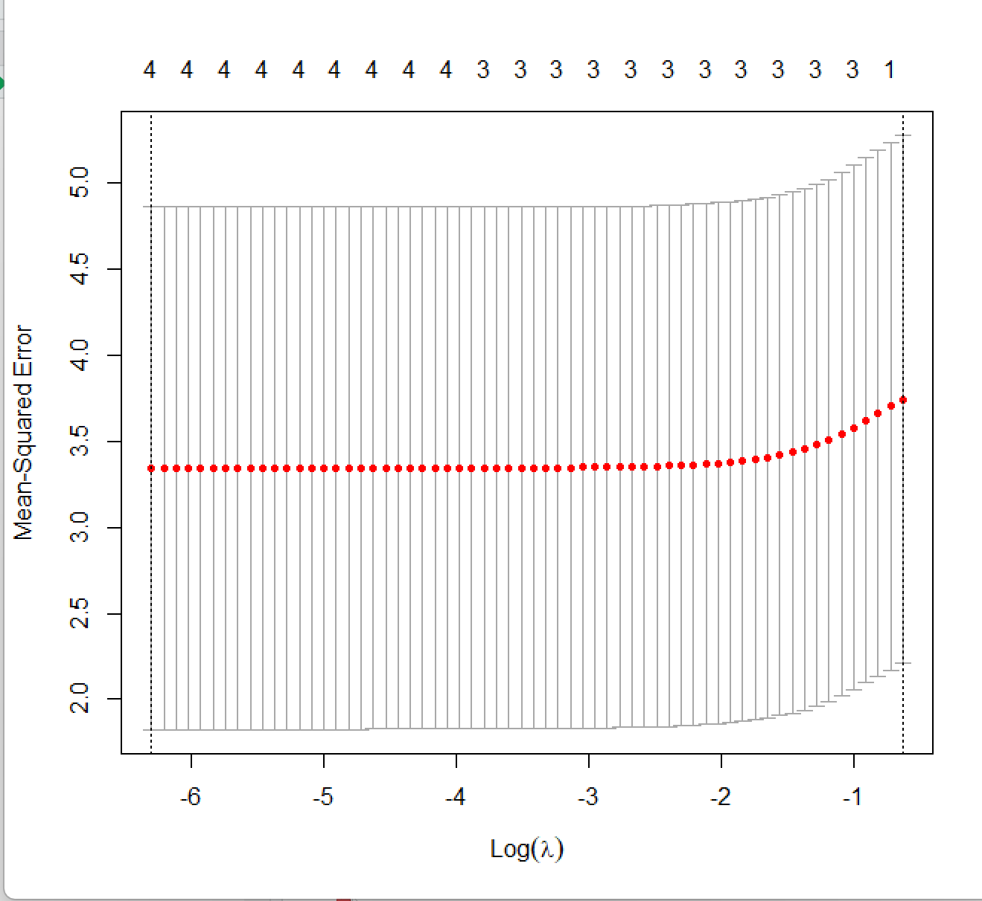
Ridge Regression Model
The Ridge Regression Model is a linear regression model used to analyze the relationship between a dependent variable and multiple independent variables. It is used when the independent variables are highly correlated.
Y = β0 + β1X1 + β2X2 + β3X3 + ... + βnXn + ε + λΣ(βi^2)
MSE : 3.326629
Critic Score and Critic Count has higher impact
on Global Sales
Notes:
Vaish
Ridge regression is a type of regularized linear regression model that is used when the independent variables (or features) in a multivariate regression model are highly correlated. In such cases, standard linear regression can produce biased and overfitted models.
From a Ridge Regression model, one can infer the impact of each predictor on the response variable, and the extent of the impact is determined by the magnitude of the corresponding regression coefficient.
Critic Score, User Score and Critic Count has higher impact out of all predictors on Global Sales

Slide 14
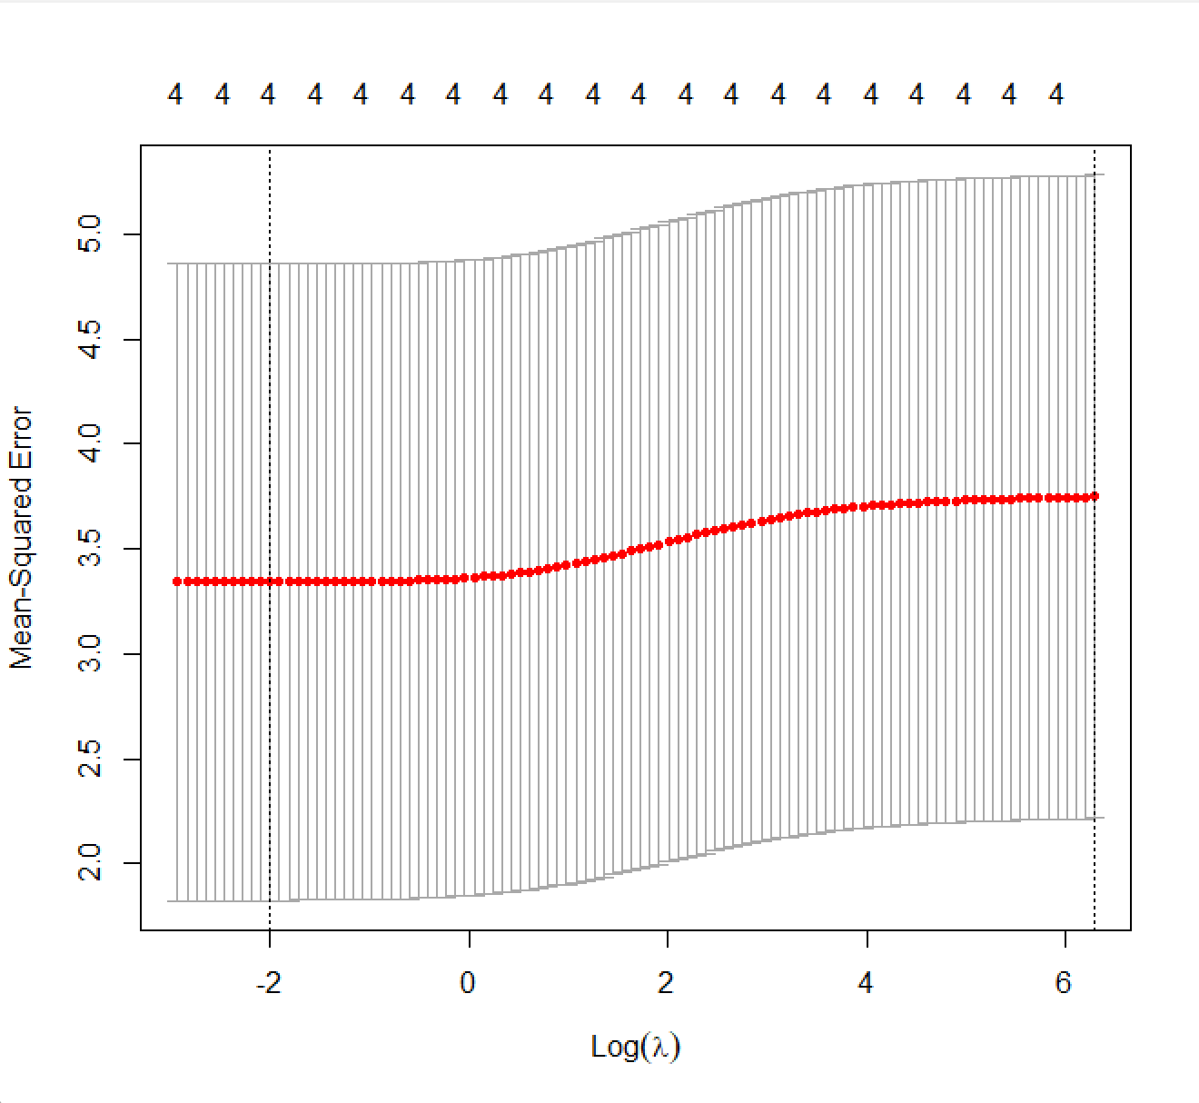
Lasso Regression Model
The Lasso Regression Model is a linear model used to analyze the relationship between a dependent variable and multiple independent variables. It is used to reduce the impact of multicollinearity and overfitting by shrinking the regression coefficients to zero.
Y = β0 + β1X1 + β2X2 + .. + βnXn + ε + λΣ|βi|
MSE : 3.321236
Critic Score, User Score and Critic Count has higher impact
on Global Sales
Notes:
Vaish
Lasso regression can be useful in situations where there are a large number of predictors, some of which may be irrelevant or redundant, as it can automatically perform variable selection by shrinking the coefficients of irrelevant predictors to zero. This can lead to simpler, more interpretable models that are less prone to overfitting.
Lasso regression is used to perform variable selection and reduce overfitting in linear regression models, particularly when dealing with high-dimensional data with many correlated predictors.
The Lasso regression model can help identify the most important variables for predicting the target variable.
n Lasso regression, the coefficients represent the magnitude and direction of the impact of the independent variables on the dependent variable.
Critic Score and Critic Count has higher impact
on Global Sales

Slide 15
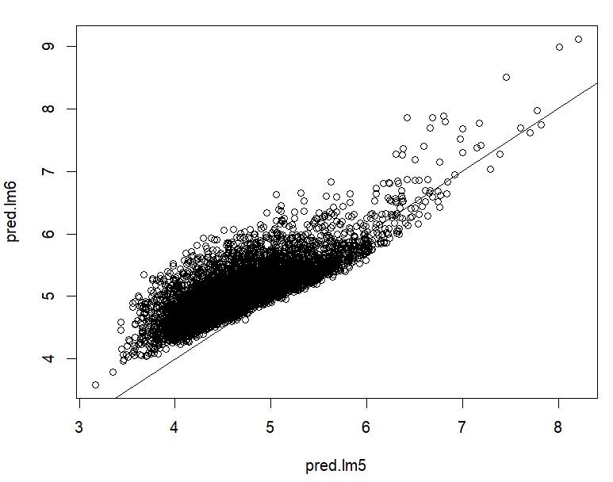
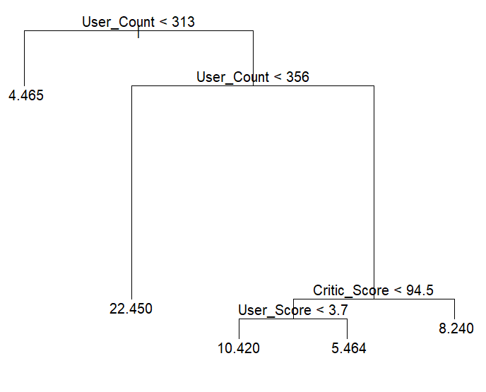
Random Forest
Definition: Random Forest is an ensemble learning algorithm that combines multiple decision trees to improve the accuracy and stability of the predictions.
Notes:
Anusha - we used a training data set with 50% and lm6 with 70%, we compared both models . After getting the predictions we see that the accuracy and performance of the Random forest model looks better.
The main use of Random Forests is to improve the prediction accuracy of the model while avoiding overfitting. It does this by creating a large number of decision trees, each trained on a random subset of the data and a random subset of the features. The output of the model is then determined by averaging the predictions of all the trees.

Slide 16
Prediction Model - Results
Models | Test Error
Multivariate Regression | 5.685017
Lasso Regression | 3.316236
Ridge Regression | 3.321629
Bagging | 4.846291
Random Forest | 3.311559
Notes:
Anusha
Multivariate - Only quantitative variable, we found main test error for quadratic and cubic polynomials
after comparing the main test error we found that it is the best fit.
Lasso -

Slide 17
Conclusion:
> In our regression analysis, the lasso model has the lowest test error with 3.321
> Comparing between the tree-based models, random forest and bagging, the random forest method has the lower test error with 3.311559
> Random forest has several advantages over other models, such as its ability to handle high-dimensional data, reduce overfitting, and provide feature importance measures, for prediction global sales we can conclude RF to be best model.
> Critic Score, User Score and Critic Count has higher impact on Global Sales.
Notes:
Anusha

Slide 18
References:
Kaggle datasets https://www.kaggle.com/datasets/rush4ratio/video-game-sales-with-
2. Video Game Industry Analysis" by Simon Egenfeldt-Nielsen, Jonas Heide Smith, and Susana Pajares Tosca.
3. "Video Game Sales Data" by VGChartz: This website provides a database of video game sales data, including global sales figures and regional breakdowns. The data covers a wide range of platforms and genres, and can be filtered by date, region, or platform.
Notes:
Anusha

Slide 19
Thank You
Notes:
AA

